Slide 1
Building a 21st Century
Working Class Movement
Southern Workers Assembly School
May 2, 2021

Slide 2
How does capitalism work?
We make it go!
Production Distribution Consumption
Workers
So, who are we?

Slide 3
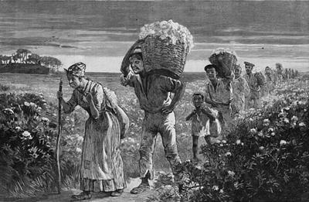
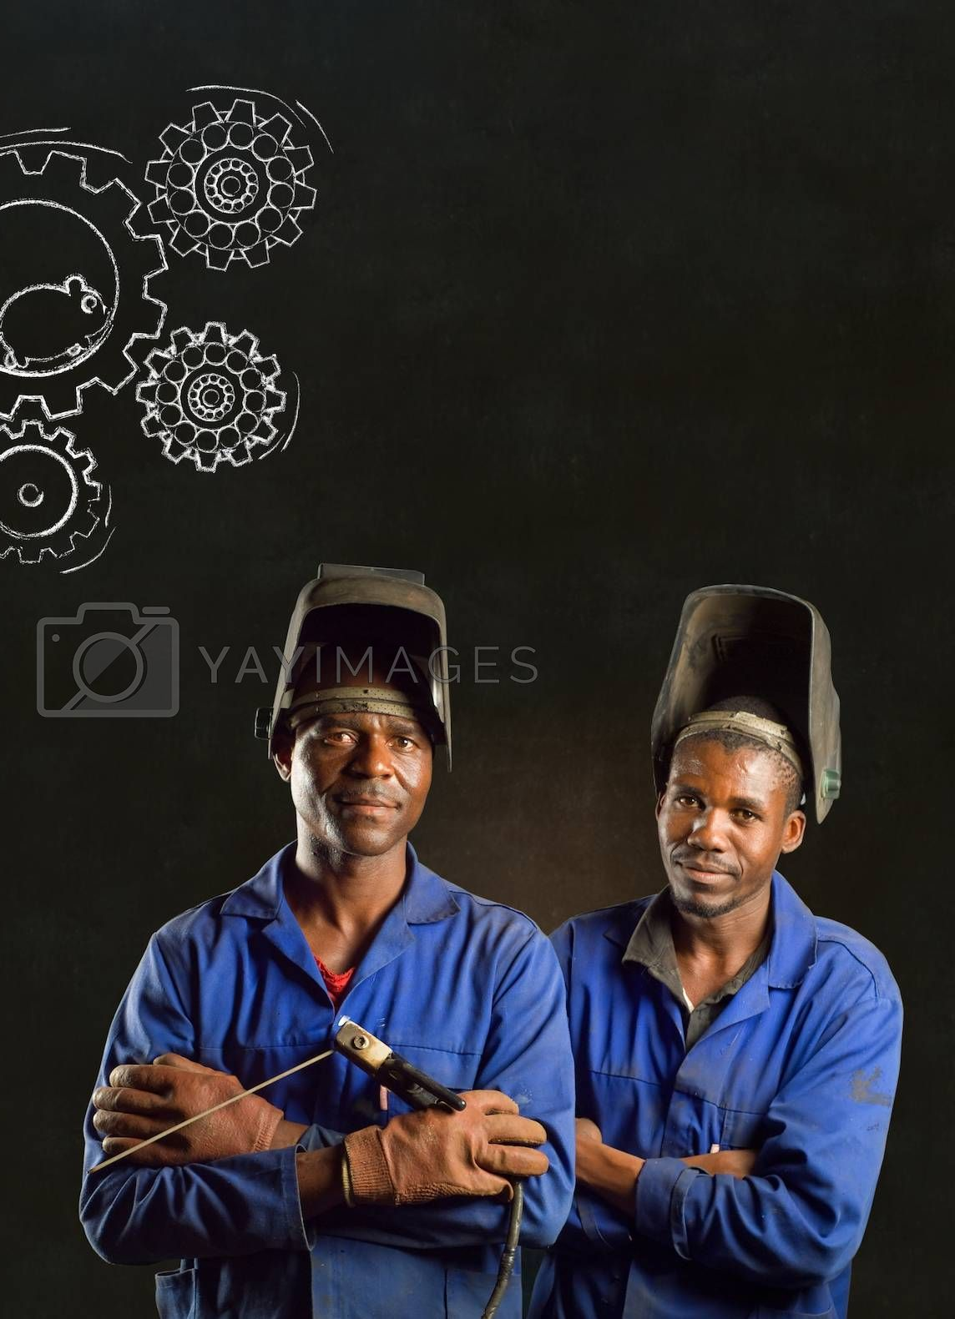
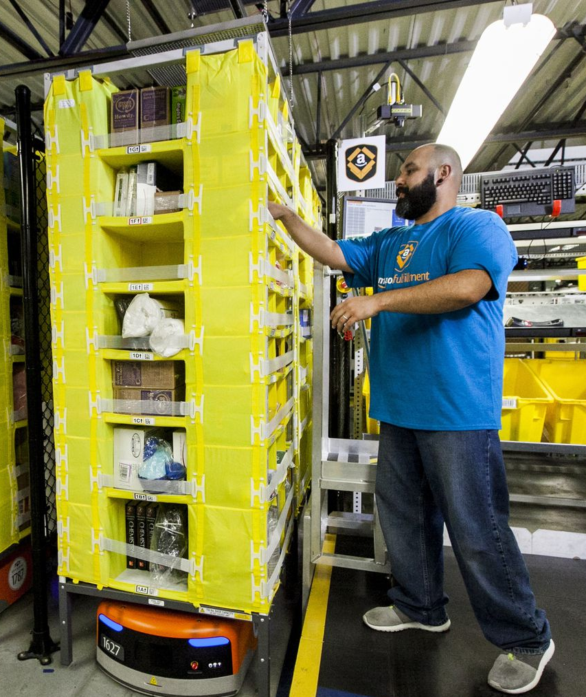
Capitalism is based on the production and sale of commodities.
In slavery, the entire 24/7 body of a worker was bought, sold and owned.
In capitalism, we sell our ability to work, our labor power.
19th century
slavery
20th century
industrial capitalism
21st century
AI capitalism

Slide 4
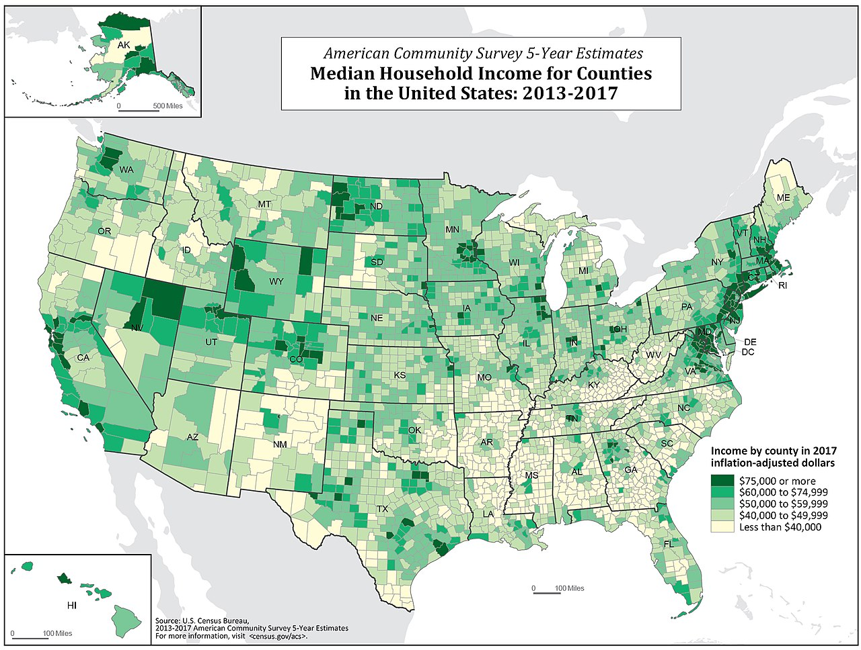
The issue is how we define a social class.
Capitalists use stratification, or levels. Mostly of income.

Slide 5
Social Class in 21st Century Capitalism
Capitalists:
Super rich billionaires
Active owners
Speculators
Middle classes
Small businesses
Elite professions
Family farms
Working class
Wage workers
Gig workers
New workers
Unemployed
Two important new developments:
Class polarization: the middle class is being forced into the working class and the billionaire class is increasing.
2. People are being forced into permanent or long term unemployment because of the robots, the new machine slaves

Slide 6
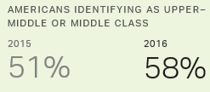
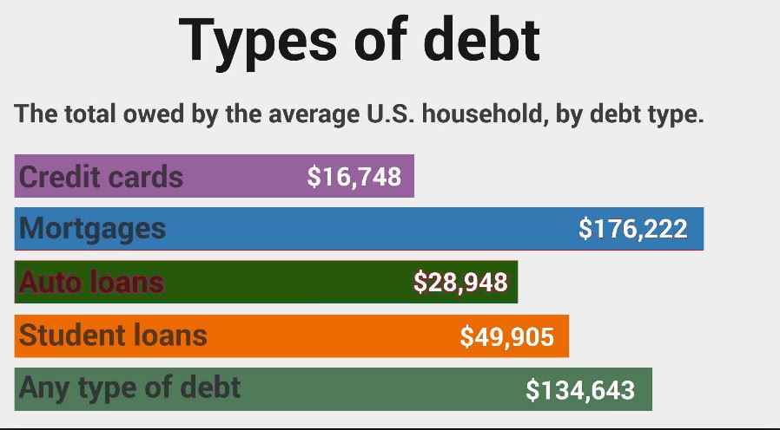
What is class consciousness? What is false class consciousness?
We win when we face reality straight
on. The capitalists win when they
get us to daydream about our lives
and go deep into debt. They try to
hide their power.

Slide 7
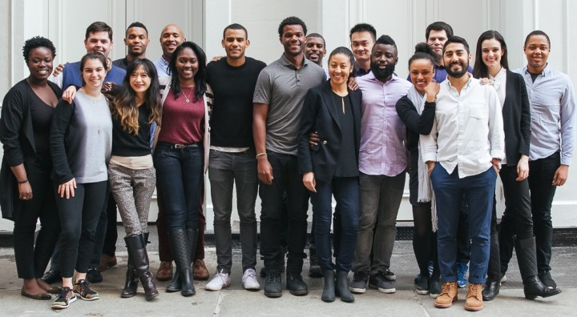
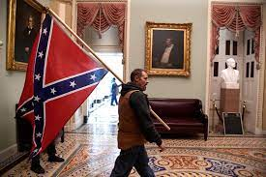
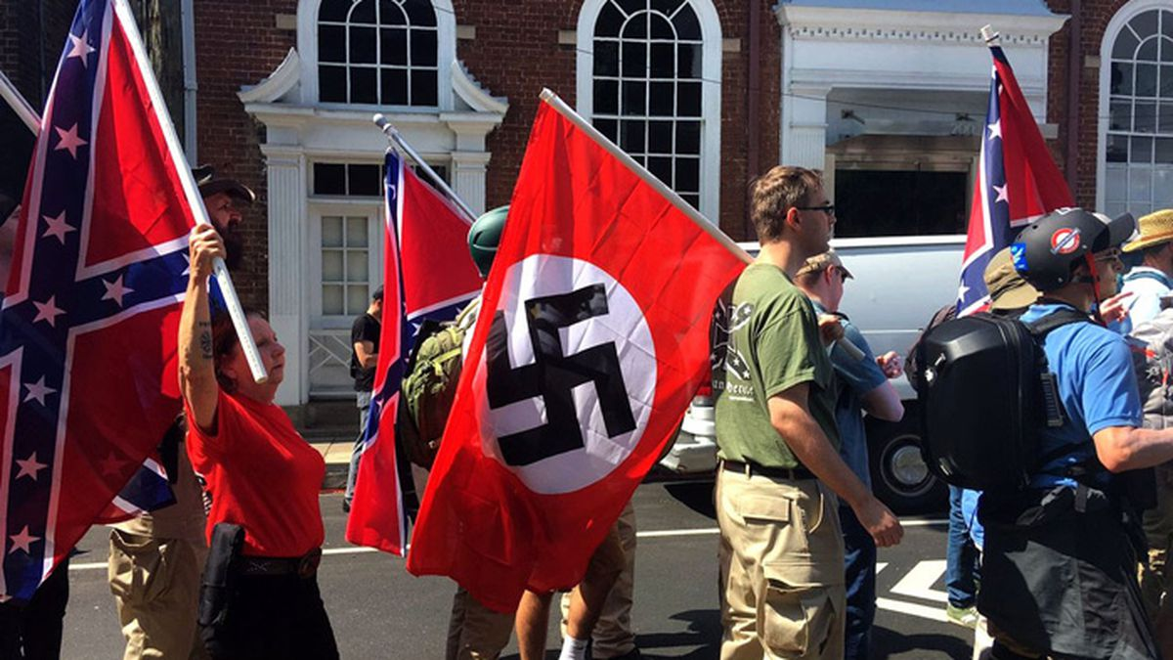
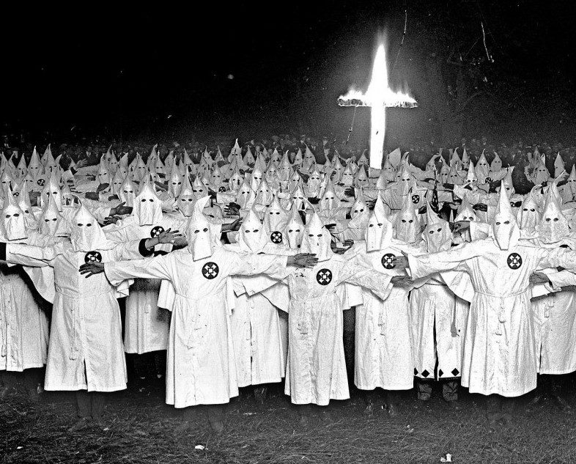
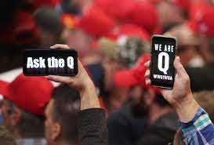
Capitalists try to divide us against each other.
Race
Gender
Region
Occupation
Salary
Age
Nationality
Immigration
Religion
Literacy
Culture
Sexual identity

Slide 8
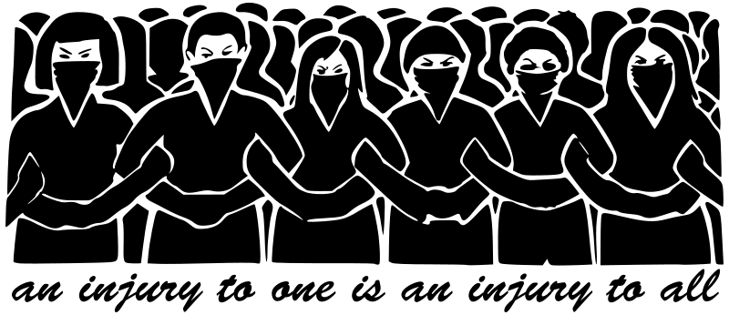
Solidarity is the key to a workers movement:
An injury to one is an injury to all!

Slide 9
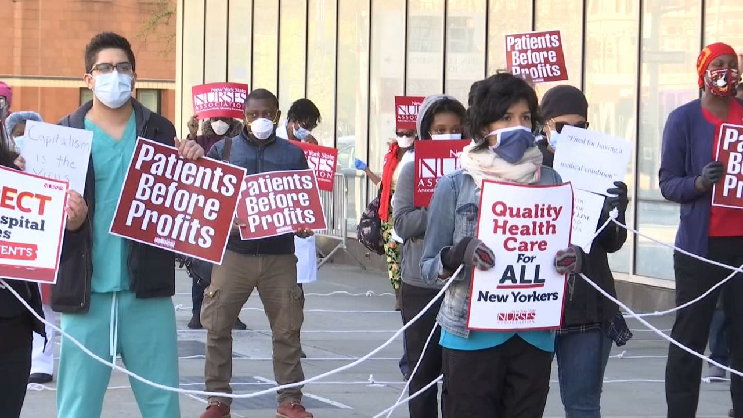
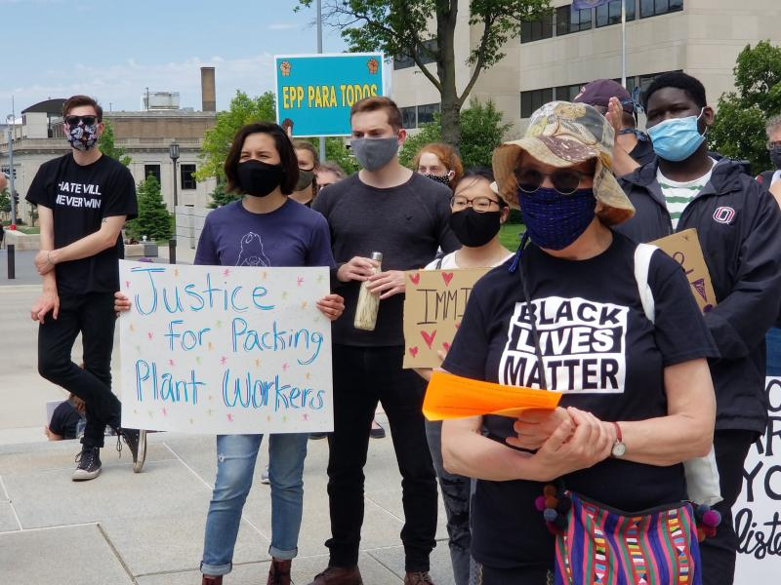
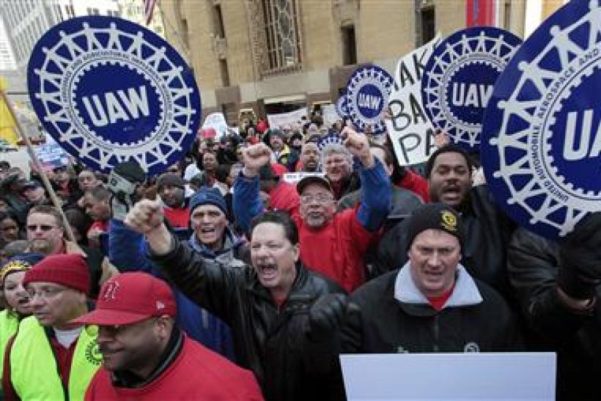
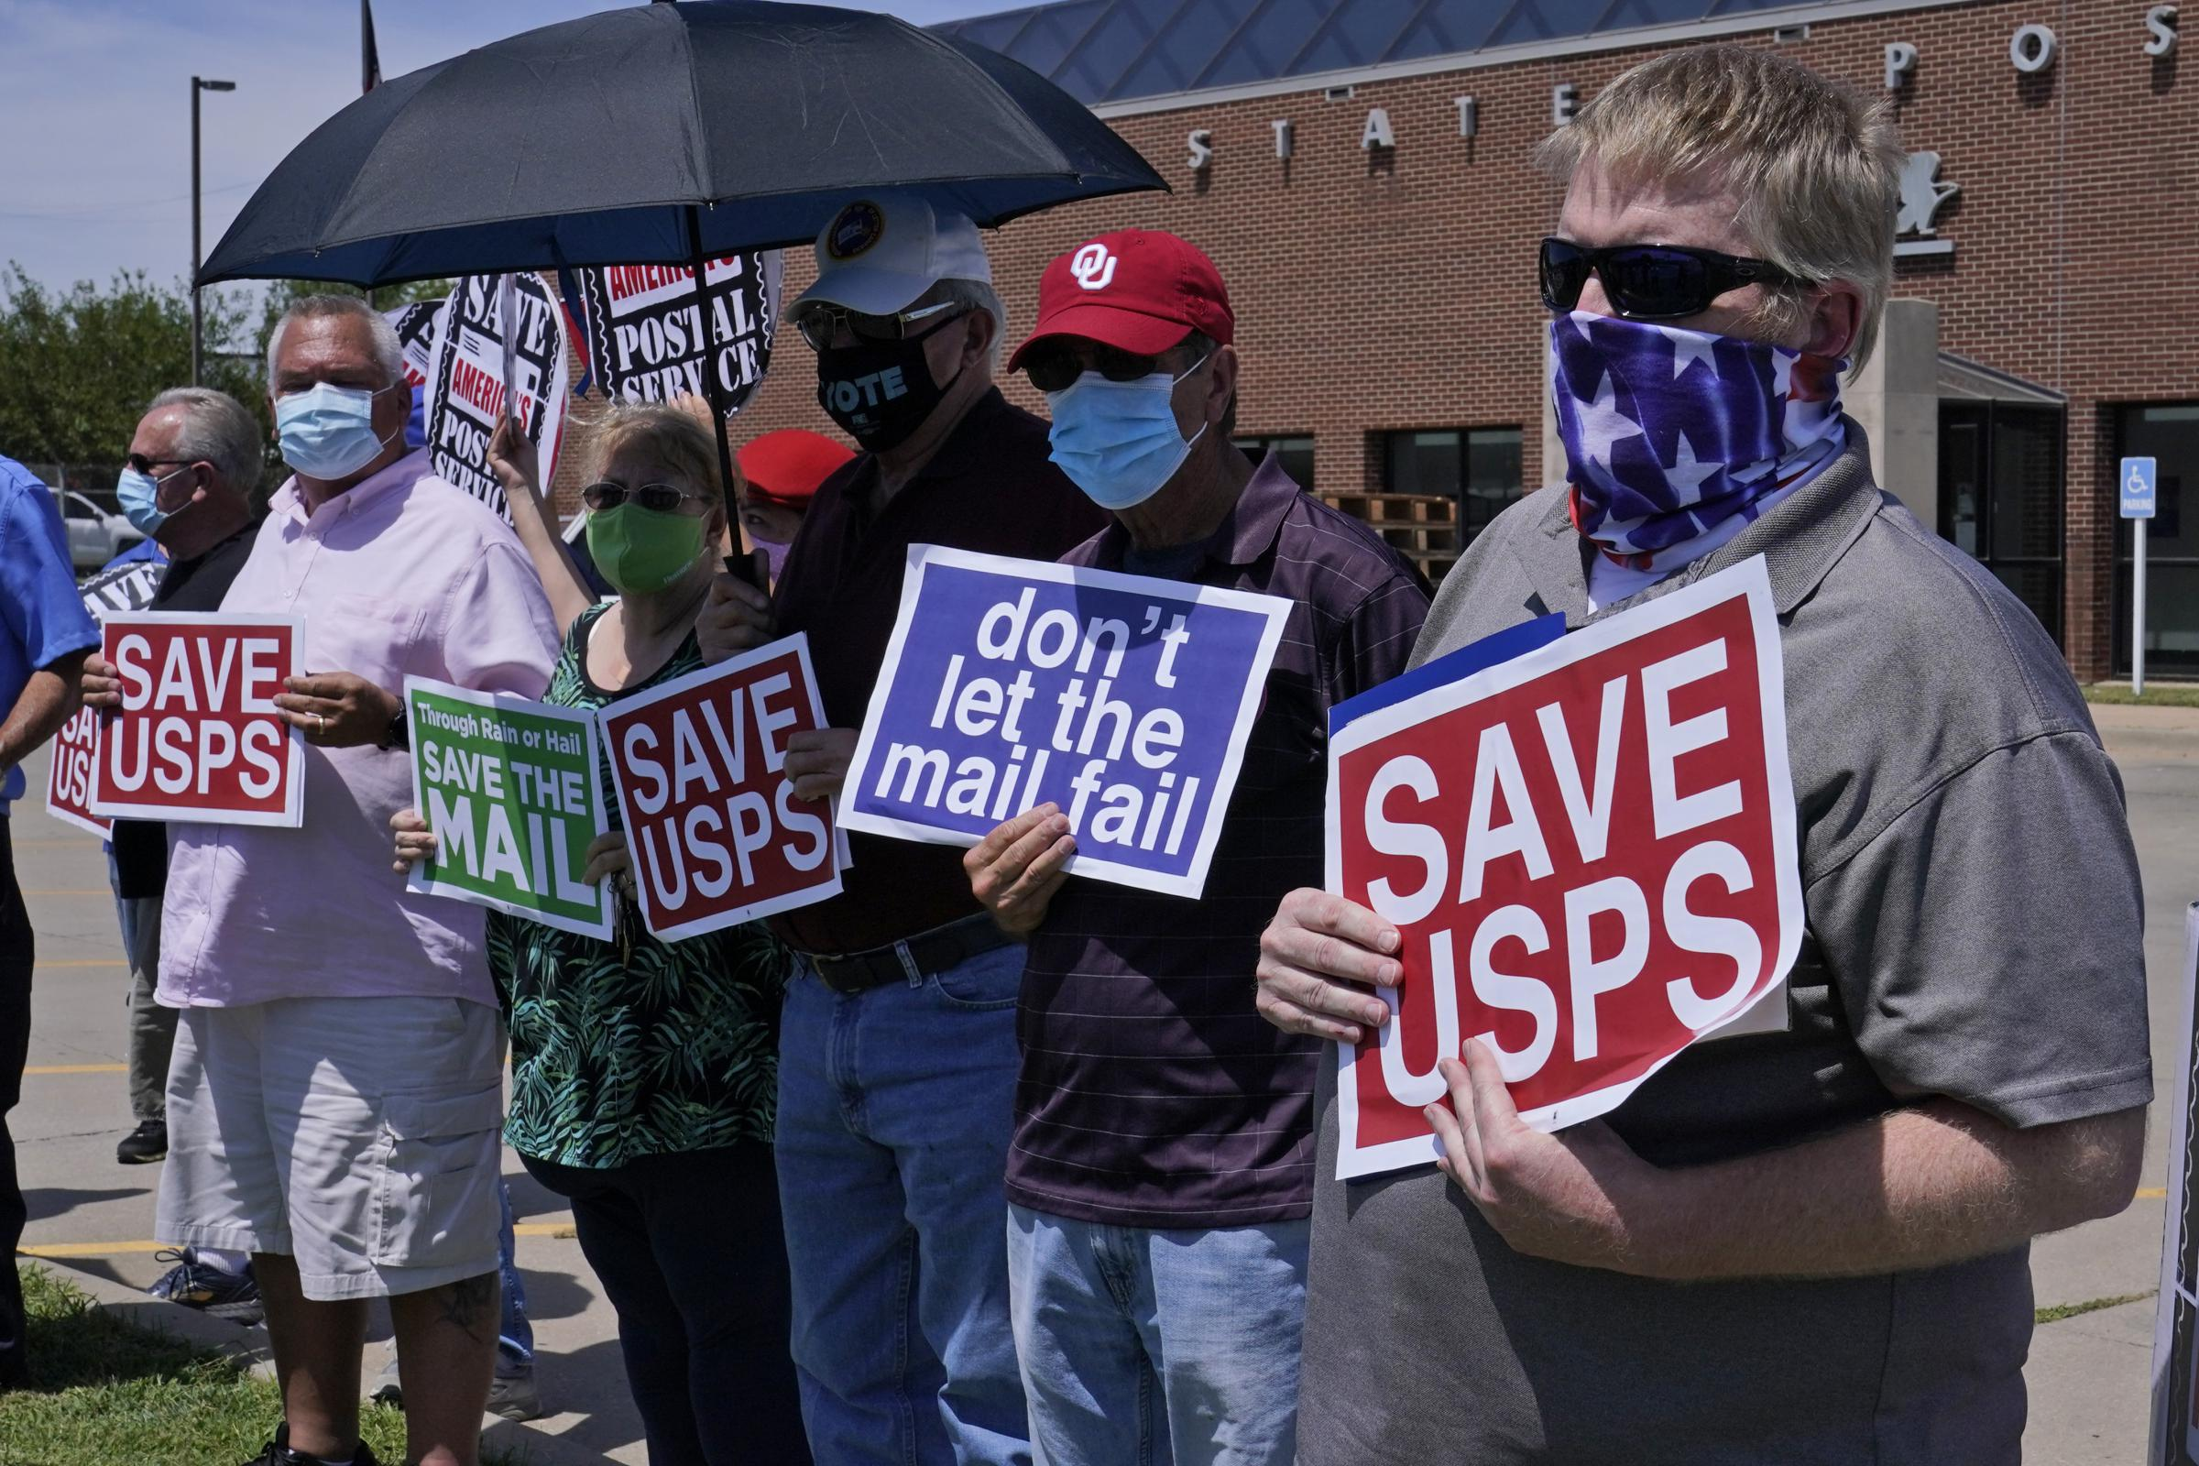
We fight in two ways:
our workplace and our community
Each workplace is a site of struggle. In each we have to organize, educate, and fight back.
Our power grows when we pull multiple workplaces into the same process.
Our goal is a movement of all workers in the same city.
Many will be in a union, and others will organize in any way they can.
Brothers/Sisters, now is the time!

Slide 10
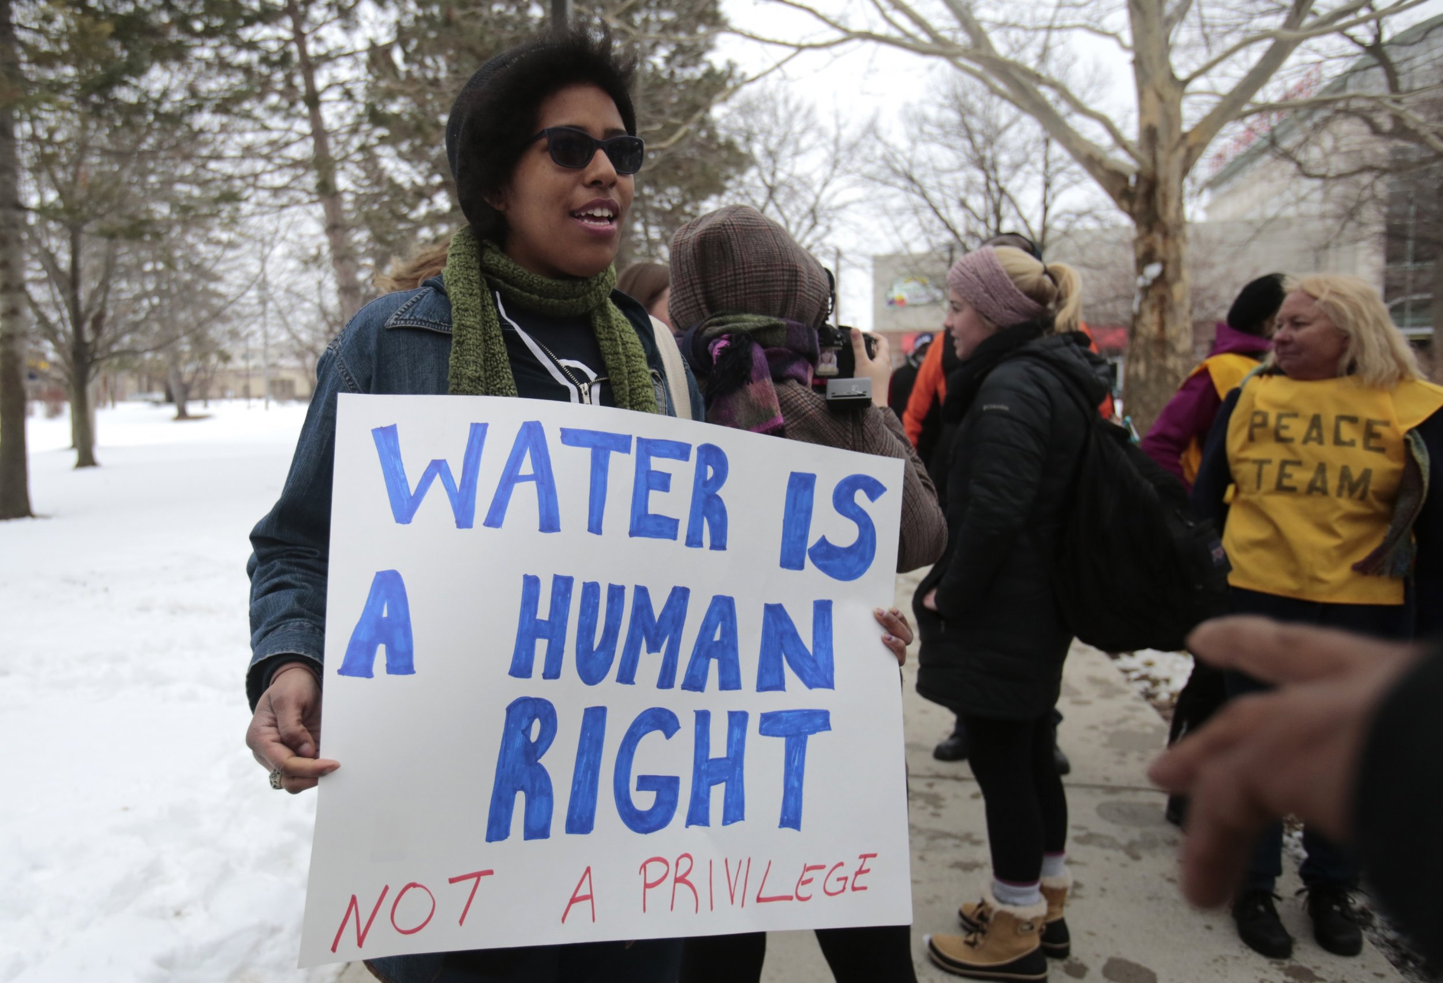
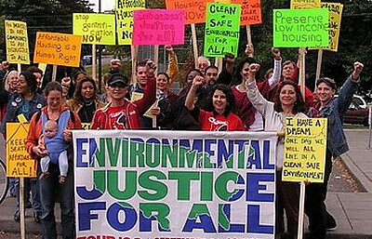
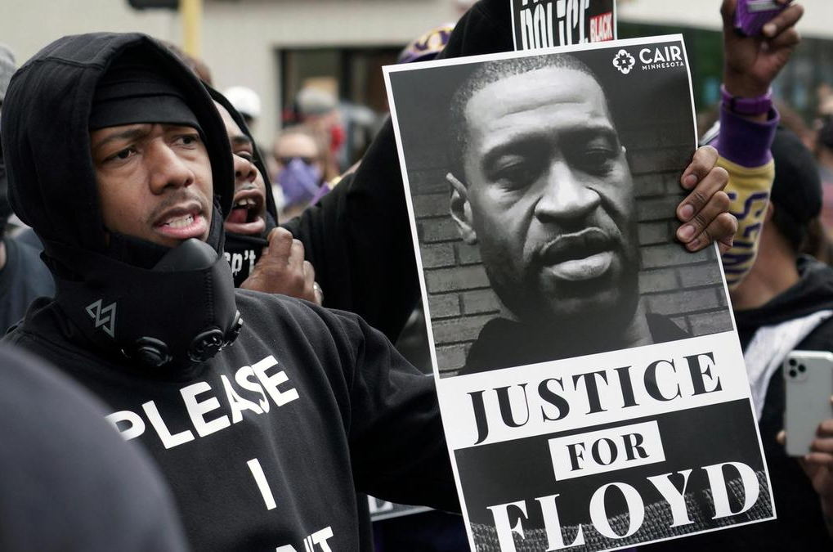
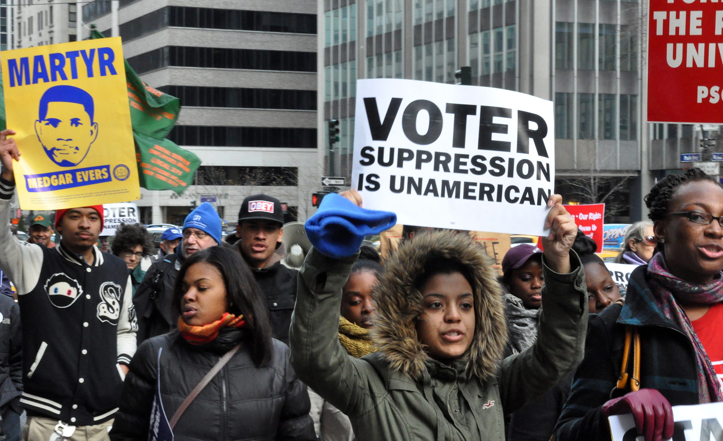
We fight in two ways:
our workplace and our community
We live in our communities
and that’s where we raise
our children.
Every social institution is
controlled by capitalists
in their interest. They
control us everywhere.
The power we develop in
our workplaces can be
used to protect and move
our communities forward.
Worker’s power is what we need.
The time to think and act is now

Slide 11
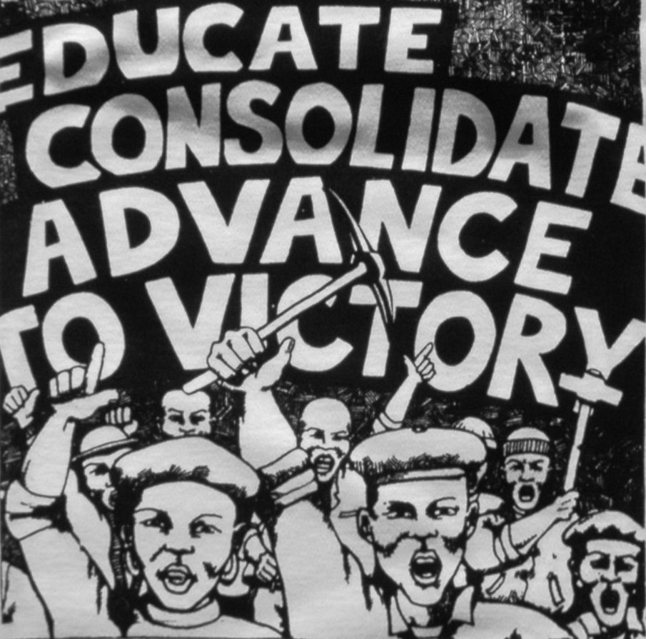
To win the class struggle, workers
must study the system to change it
Political literacy is the key to victory

Slide 12
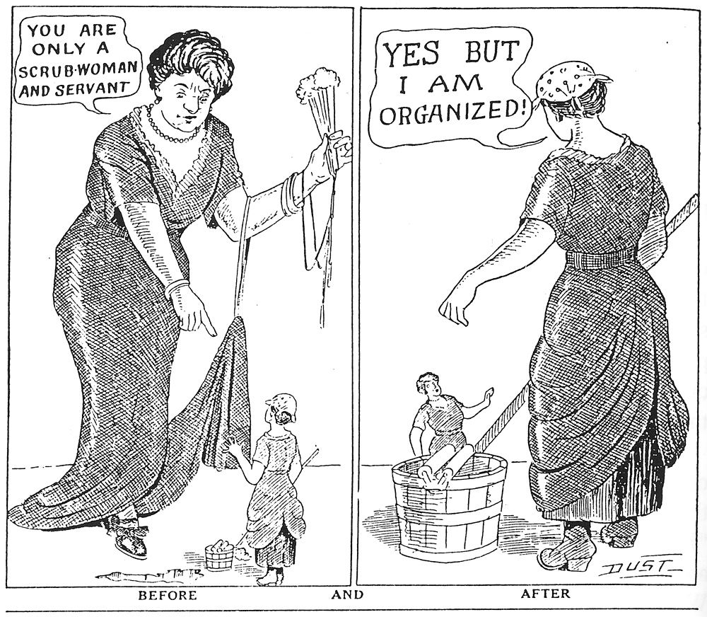
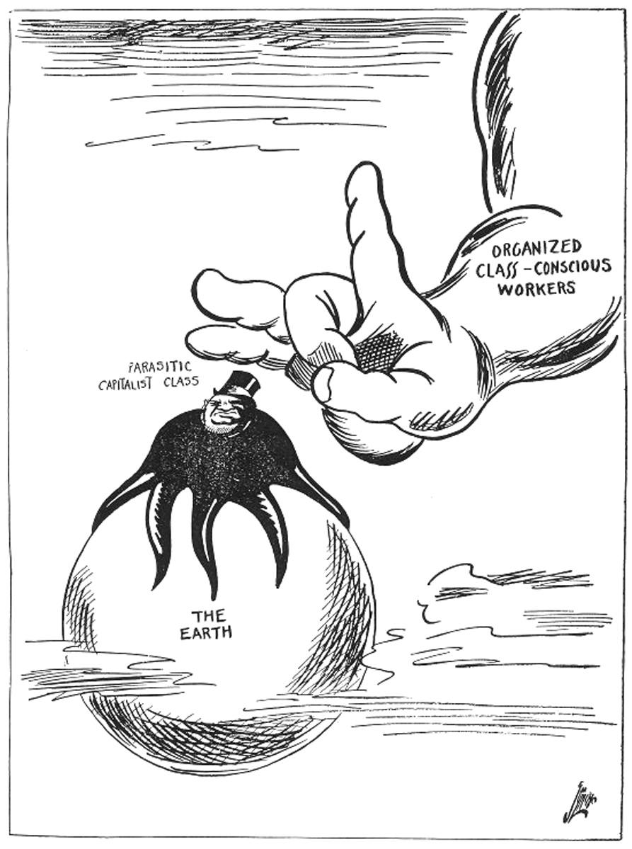
Consciousness is key
Class conscious workers can build a mighty movement

Slide 13
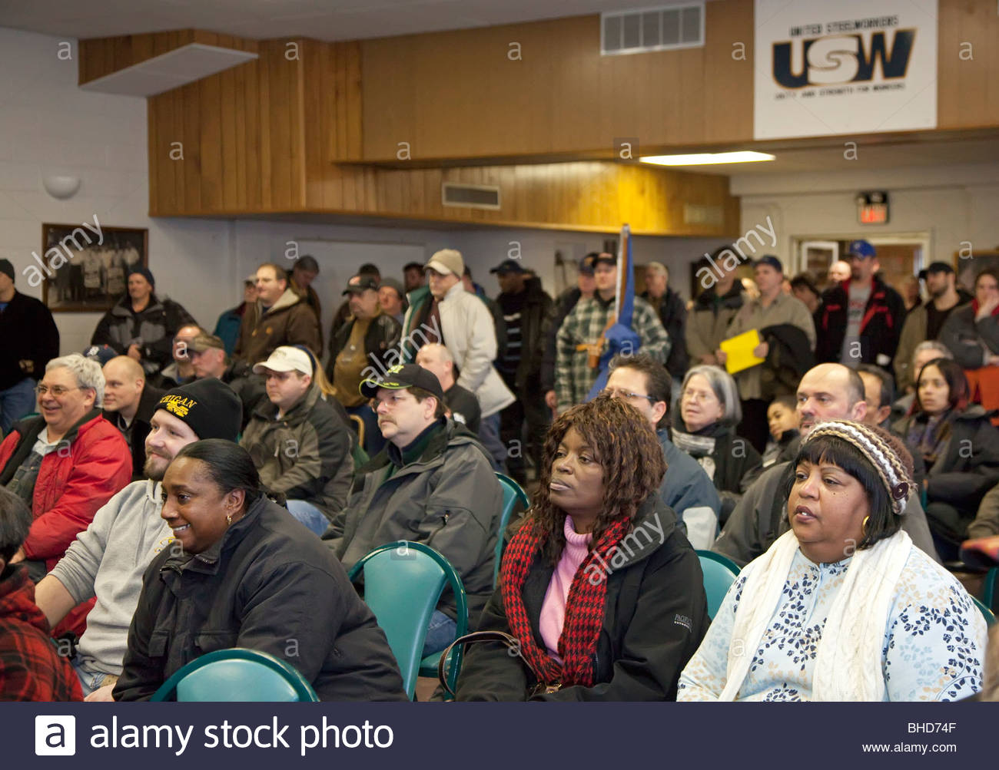
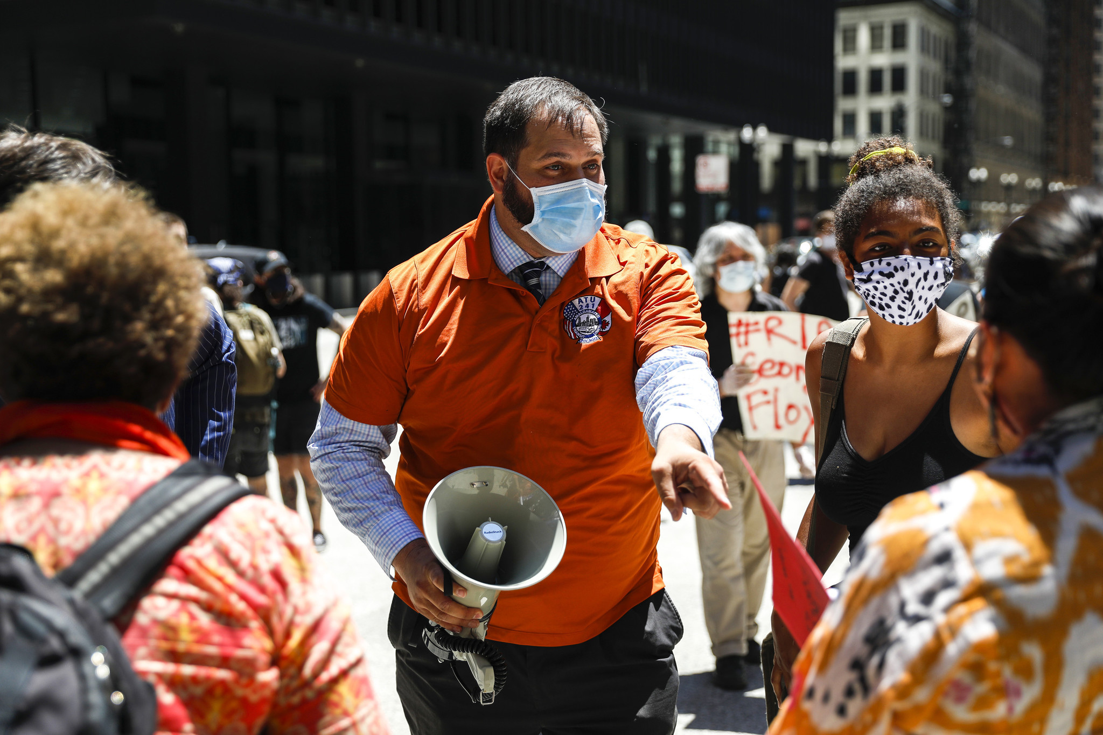
Organization is key
Collectivity
Democracy
Accountability
Record keeping
Consensus
Knowledge
Independence
Gender balance
Leadership
Communication
Mobilization

Slide 14
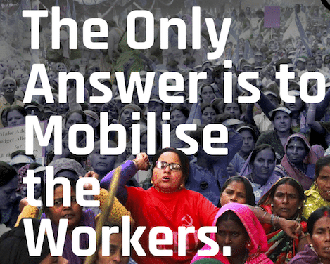
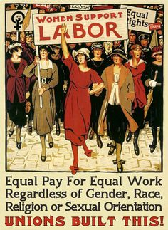
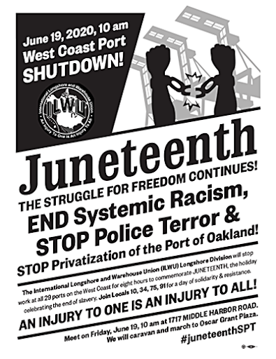
Mobilization is key
First, we meet in small groups. Then we expand our network and begin to march. Like a rolling snowball we grow and build until we
capture the imagination of the majority. Then we mobilize as a class.

Slide 15
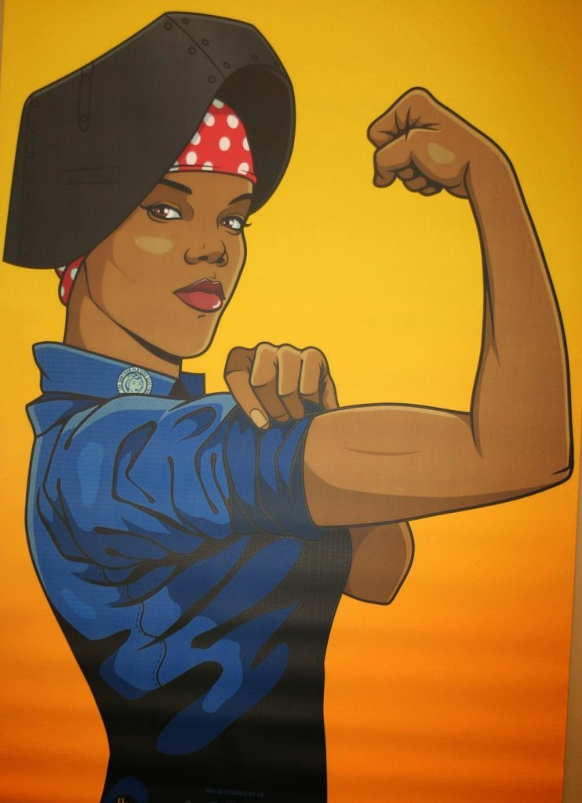
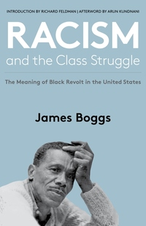
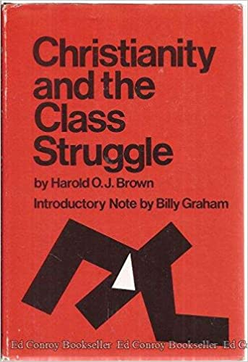
WE NEED WORKING CLASS POWER
Our daily struggle is over surplus value.
What do we need?
A shorter working day. Fewer hours, same take home pay. 30 for 40. A 4 day week.
Increased pay with productivity increase.
Every worker needs a job and/or a livable income

Slide 16
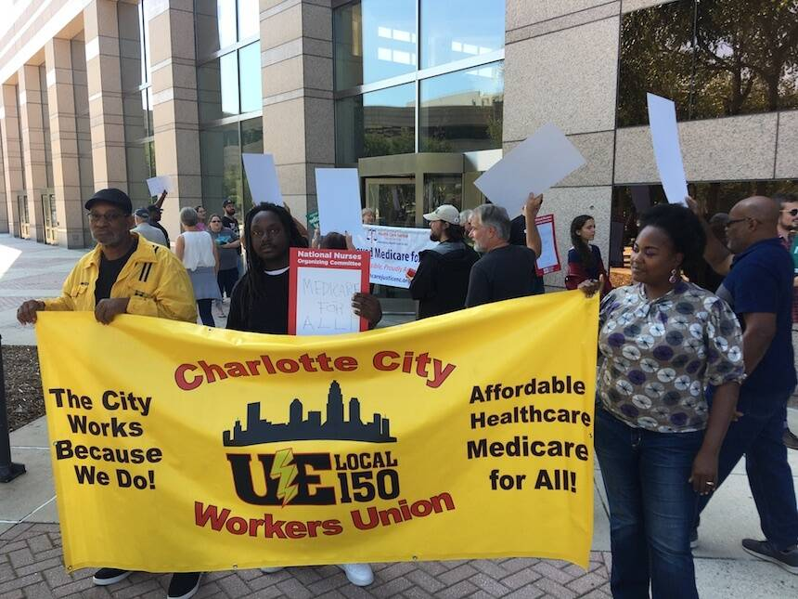
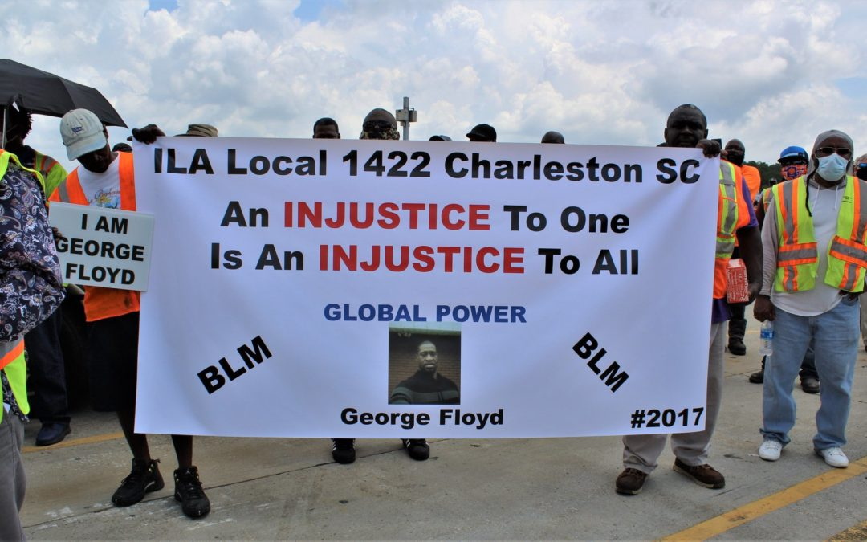
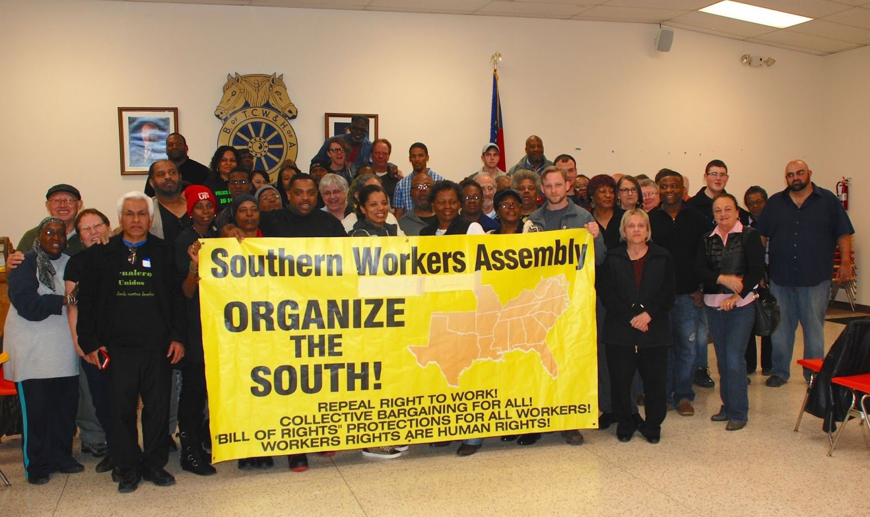
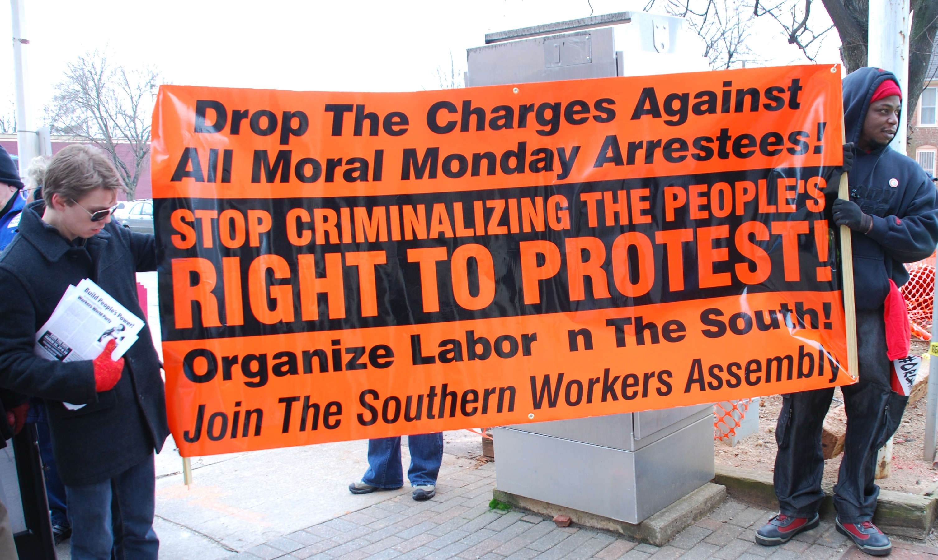
A 21st century working class movement is needed now.
Organizing the south can lead the way.

Slide 17
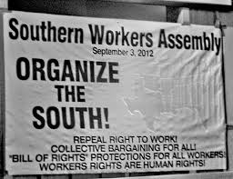
This presentation is available as a pamphlet from the SWA

Slide 18
Questions?

